Slide 1


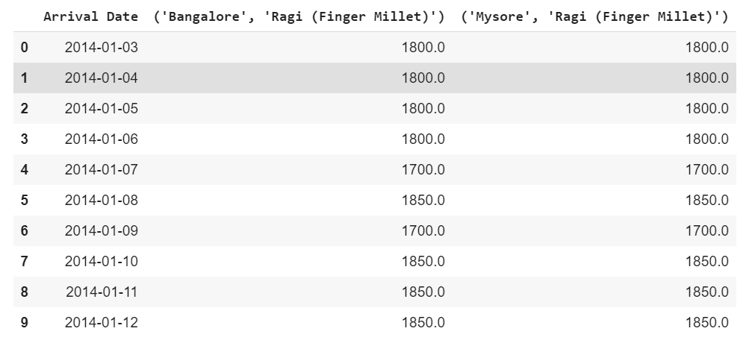
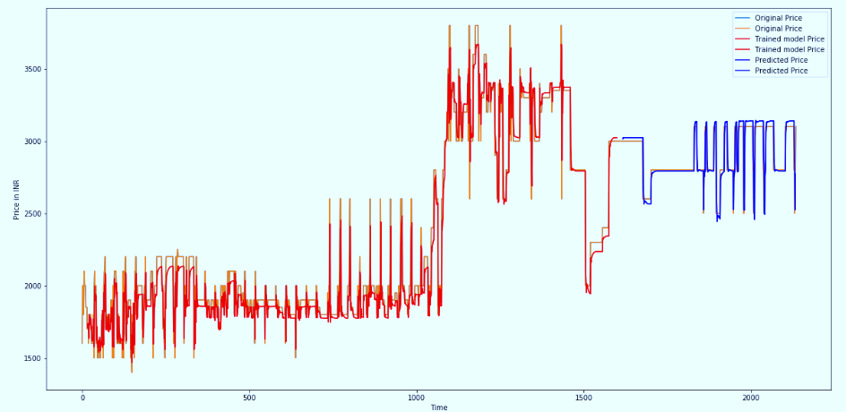
Finger Millet (Ragi) Price Prediction using RNN
Narayana D, Abdul Sheraz K R, Naveen Kumar Thippirishetty, Pradeep Sanchana,
Sandesh Ramesh Kannur, Vaishnavi K from Great Lakes Institute of Management
ABSTRACT
INTRODUCTION
DISCUSSION
Finger millet is one of the most important in the tropics covering 12% of global millet area. The major producers are Uganda, India, Nepal, and China. Finger millet is a rich source of calcium, iron, protein, fiber and other minerals and is a gluten-free food. The cereal has low fat content and contains mainly unsaturated fat. Major ragi producing states in India are Karnataka, Tamil Nadu, Odissa, Andhra Pradesh, Uttarakand, Maharashtra, Uttar Pradesh and Himachal Pradesh. The area covered under ragi in Telangana during 2017-18 was 460 ha.
Predicting millets prices will be useful and decision making for farmers, agri-business industries.
The price behavior of a commodity plays a crucial role in farm-level crop production planning. We are attempting to forecast millet price using statistical time-series modeling techniques- Long Short Term Memory(LSTM) which in on Recurrent Neural Network(RNN) models.
The data used in this study include the monthly wholesale price of millet from January 2006 to October 2019.
Problem of predicting millets market price can be solved using Structural and Time-Series. Here we’re solving using Long-Short-Term-Memory (LSTM). It is artificial recurrent neural network (RNN) used for the deep-learning and It is a good choice for sequence prediction problems which finds the patterns and solves the problem. It is also used to predicting sales to find patterns into the stock market exchange. it is found that for almost all of these sequence prediction problems, LSTMs have been observed as the most effective solution.
Traditional neural networks cannot remember more of the past, but only the recent past (short term memory) and this is considered as a shortcoming of these networks. RNN can fix this problem.
LSTM and GRU well-suited for processing, predictions based on time-series data.
Table 1. After Pre-Processing the Data with forward fill.
Predicting Millets prices helps to the farmers, Agri business on the crop planning, price planning, stock management, transport management.
CONCLUSIONS
In recent years, great efforts have been undertaken on the challenging task of predicting Millet price. Developing accurate models for predicting price using Information and Communication Technologies may help farmers and other stakeholders improve decision making in relation to national food import/exports and food security.
In future we can add more features such as comparison of different crops within the same city, also we can make use of this model to compare multi city with multi crops which will understand the correlation and predict future price with more accuracy. The most important factor for successful prediction would be high-quality and up-to-date data.
RESULTS
Initially the above described model is used with the split of 1056 training data and 264 test data with the and trained the model as Sequential with using epochs of 20.
And Calculated Root Mean Squared Error estimator. It gives the standard deviation of the residuals. It tells how spread out these residuals, measure of how far from the regression line data points and best fit.
Below are the results got from Training Model.
Train Score: 736.15 MSE
Test Score: 396.56 MSE
And Plotted the predicted graph and below are the performance of predicting model
METHODS AND MATERIALS
REFERENCES
Data Collection -
Collected more than 15 years (2001 to 2019) of data from Data.gov.in (Indian government data website) on Ragi and other few millets. The data has State, District, Market, Commodity, Variety, Arrival Date, Min Price, Max Price, Model Price.
Data Pre-Processing
Combined all the years of data files to one file. We’re building two initial models on Min and Max Pricing, on a particular market (Bengaluru and Mysuru) with the fine variety, and validating null values if there are any we are using Forward fill method with using frequency Date. Frequency date helps to fill the missing dates, Forward fill method helps to fill the empty values with a previous date value.
Train, Test Split
Data has been split in to First 75% of data to Train and remaining 25% to the Test and scaled the values using MinMaxScaler with feature range of 0,1.
1. Pearl and Finger Millets: The Hope of food Security by Anubha Shukla, Adarsh Lalit, Vinay Sharma, Sharad Vats and Afroz Alam
Applied Research Journal Vol.1, Issue 2,pp.59-66,April,2015
2. Processing of Millets – by S. Balasubramanian
National Seminar on Recent Advances in processing, utilization and nutritional impact of small millets, At I, 1-14, Volume: I, 1-14
Image 1 – Performance of Predicting Model
CONTACT
ABDUL SHERAZ K R
NAVEEN KUMAR THIPPIRISHETTY
PRADEEP SANCHANA
SANDESH RAMESH KANNUR
VAISHNAVI K
Contact :9620828735
Email :Sandeshkannur@gmail

